Slide 1
Reconstruction algorithm and phase calibration of phase contrast imaging
小组成员：王 菲 陈佳琦 谢铭效

Slide 2
1 Phase Reconstruction

Slide 3
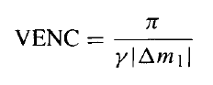
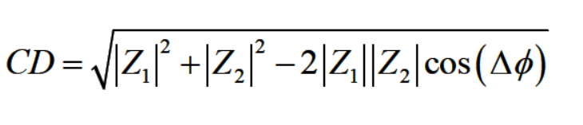
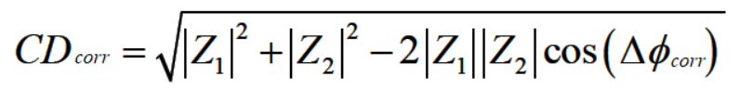
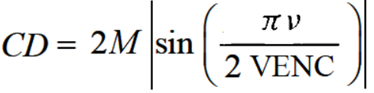
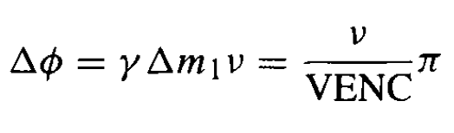
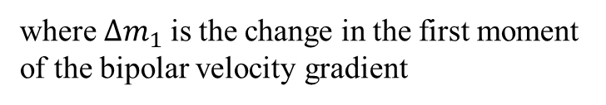
Phase/Complex Difference Reconstruction
Defination of the aliasing velocity (VENC)
Complex Difference Reconstruction
where $Δm_{1}$ is the change in the first moment of the bipolar velocity gradient
Assume that
Phase Difference Reconstruction
For mutiple coils (Phase arrays)
Bernstein, M. A., King, K. F., & Zhou, X. J. (2004). Handbook of MRI pulse sequences. Elsevier Academic Press.
Notes:
老师在课上讲过，phase和complex两种成像方法。这两种的理论都很直白。
首先我们假设混叠速度VENC的定义，这是一个人工选取的数值，假如它越小，它对低流速的采集灵敏度就越高。再假设由傅里叶重建计算出来的复数分别为z1z2.
对于phase different，最好的方法是直接用用z1乘以z2的逆再求角度，如果推广到多线圈，加上不同的权重可以写成这个式子。用venc表达是这个样子。
对contrast difference，公式是这样，通常这里会有对eddy current的校正，写成venc表达是这样，如果是三维的计算方法是这样。这些在课上讲过。

Slide 4
Phase/Complex Difference Reconstruction
Phase Difference Reconstruction
Complex Difference Reconstruction
Bernstein, M. A., King, K. F., & Zhou, X. J. (2004). Handbook of MRI pulse sequences. Elsevier Academic Press.
Notes:
VENC has units of speed and is usually quoted in centimeters per second.
The smaller the value of VENC, the greater is the sensitivity of the acquisition to slow flow.
PC images
reconstructed with phase difference have two main applications: determining
the flow direction and quantifying flow velocity and volume flow rate.

Slide 5
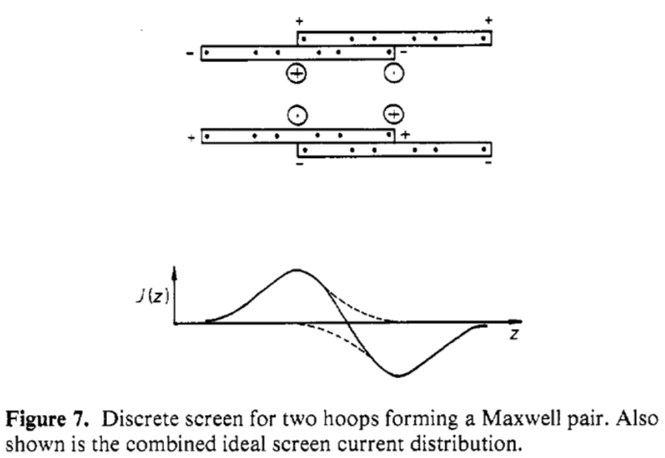
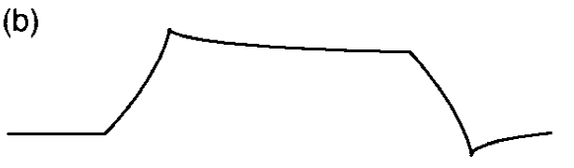
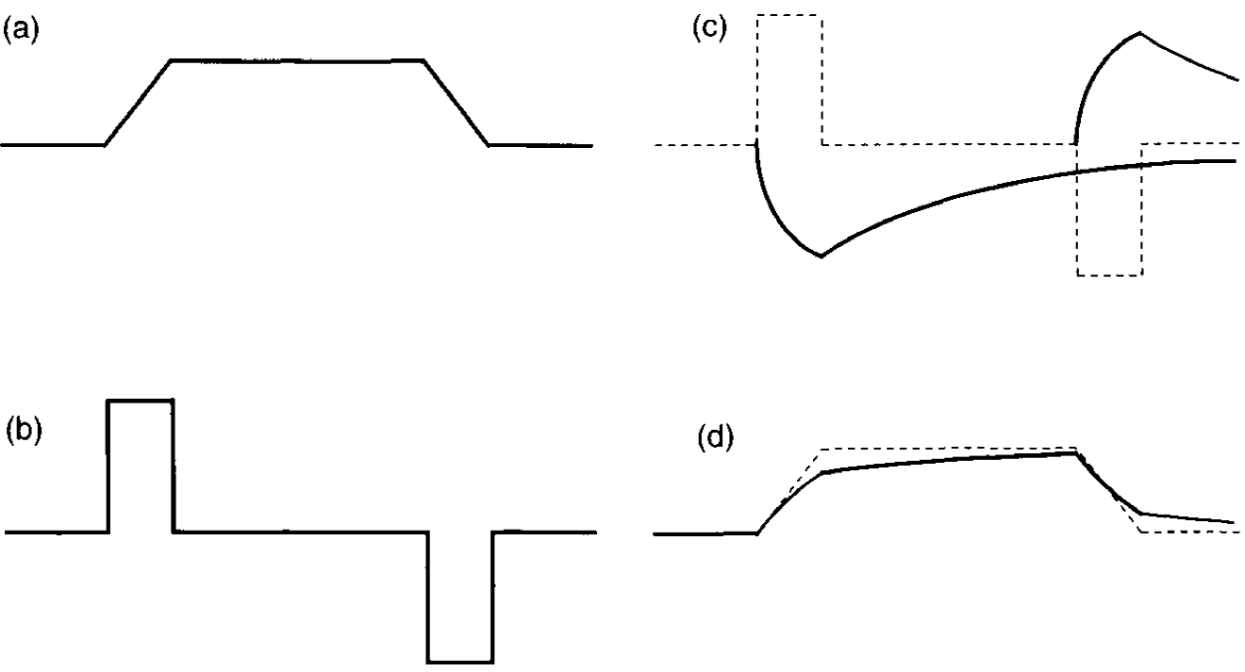
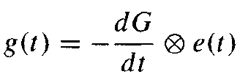
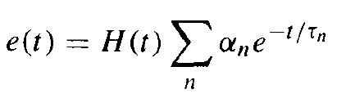
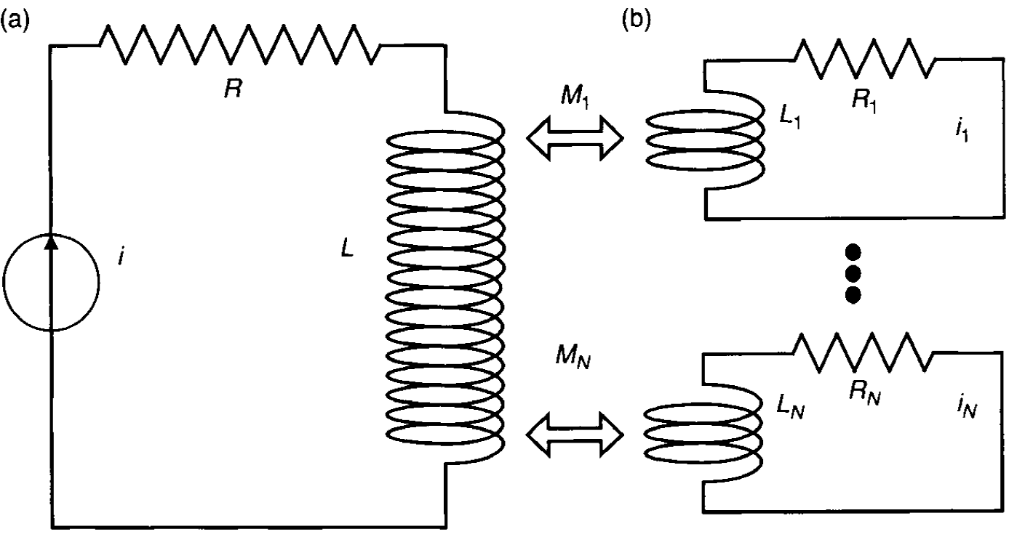
Eddy Current
Shielded Gradient Coils
Preemphasis Compensation
Linear component
Faraday's law
proportional to the gradient slew rate
Preemphasized(high-pass-filtered)
waveform.
The cancellation concept
B₀ component
plateau length and the decay rate of eddy current
Eddy-Current Time Dependence
Waveform Preemphasis
using a B₀ coil with current control that can be varied in real time or shifting the exciter / receiver frequency
intentionally distort the current waveform
Eddy-Current Spatial Dependence
Gradient Waveform De-rating
Decreasing the amplitude of the trapezoid while holding the slew rate fixed
a spherical harmonic expansion
moving /using multiple samples
Bernstein, M. A., King, K. F., & Zhou, X. J. (2004). Handbook of MRI pulse sequences. Elsevier Academic Press.
Mansfield, P., & Chapman, B. (1986). Active magnetic screening of coils for static and time-dependent magnetic field generation in NMR imaging. Journal of Physics E: Scientific Instruments, 19(7), 540-545. doi:10.1088/0022-3735/19/7/008
Notes:
对于梯形波形，净梯度场(理想场加涡流场)表现为通过低通滤波器，上升和下降坡道的角四舍近入，如图10.12所示。
任何梯形梯度叶的上升和下降坡道所产生的涡流都可以看作是独立的实体。
由于这两个涡流场的符号相反，在梯形波形完成后，它们部分抵消。
对消的程度取决于涡电流场的平台长度和衰减速率。
这种对消概念被用在一些涡流还原方法中.需要注意的重要一点是，梯形完成后的涡流振幅与平台振幅成正比，因此可以通过使用较低的振幅梯度来降低。
研究发现，涡电流的时间依赖性可以用指数函数(Van Vaals和Bergman 1990;
Jehenson等人，1990)。
利用该模型，涡电流的特征是少数时间常数和系数，称为振幅。
时间常数描述了梯度变化后指数积累和衰减的速率。
商用扫描仪上的涡流时间常数从几微秒到数百秒不等。
涡流的空间依赖性主要分为在成像体积上空间恒定的B0涡电流和与成像梯度场相似的线性空间变化的线性涡电流。
高阶空间依赖关系是可能的，但通常不测量或
纠正。因为k空间位置与累积相关
在梯度波形的作用下，线性涡电流可以实际位移
相对于理想位置的k空间位置。
例如，当线性涡流
电流存在于读出方向，k空间的中心出现在稍后
在读出比预期的。
此外，在高原期间的k-space读取间隔
梯形的梯度幅值小于
理想。
在相位编码和切片选择过程中也会发生类似的k空间偏移
的方向。
涡流引起不必要的相位积累，但是
而不是像线性对应的k空间位移。
在某些应用中，涡流引起的k空间位移和相位
积累是良性的。
例如，在常规成像中用a
直线k-空间光栅，在频率编码的k-空间均匀位移
方向只是在频率方向上产生一个附加的相位斜率
不影响星等图像的。
然而,对于序列
例如在前后光栅中遍历k空间的EPI，即k空间移位
而相位积累会导致重影。
涡流k空间的位移可以
还会导致图像压缩、剪切或位移。
屏蔽梯度线圈背后的想法
(曼斯菲尔德和查普曼1986)是使用两个线圈，一个主内部或主线圈，
和次级外圈或屏蔽线圈(有时也称为巴克线圈)，
它们串联在一起。
对于水平磁场(圆柱形)磁铁，则
两个线圈安装在同心圆筒上。
对于垂直磁场磁铁，则
同轴盘上有两个线圈。
线圈的相同命名法
用于这两种类型的系统。
屏蔽线圈产生一个与之相对的磁场
主线圈的磁场。
直径、导线形状和电流
对两线圈的网外磁场进行了设计
(边缘场)越接近于零越好。
因为涡流主要是流动的
在导电结构外的屏蔽梯度线圈，减少了条纹
磁场减少涡流。
两个线圈的磁场也部分抵消
在成像体积内相互作用。
因此需要更多的电流
产生与未屏蔽梯度线圈相同的磁场。
这种效果可以
由梯度效率量化，梯度效率有时定义为
峰值梯度振幅与旋转速率的乘积。
a的效率损失
屏蔽结构取决于主从之间的距离
线圈与线圈之间的电流比。
增加的距离
提高了效率。
例如，对于圆柱线圈，效率比
在屏蔽和非屏蔽配置之间可以是1.5或更多。
屏蔽
梯度线圈通常将涡流振幅降低10到
100相对于振幅没有屏蔽。
屏蔽梯度线圈
用于几乎所有的商用扫描仪，并提供第一道防线
针对涡流。
式(10.35)中的第一项通常称为Bo涡流。
第二个
这一项叫做线性涡流。
由~、gx、gy和
表示沿三个物理梯度轴的涡流梯度
分别是x y z。
高阶项通常不被考虑
没有标准名称。
大多数图像质量问题通常都可以追踪到
到式(10.35)中两项中的一项。
用B0表示的分解
线性涡流是有用的，因为校正方法有时是有用的
这两个组件是不同的(参见后面的讨论)。
方程(10.35)
可以等价地认为是球谐展开。
这种扩张
与泰勒级数的不同之处在于二阶和高阶项的性质
分组。
在一个简单的涡流模型中
支持涡流的导电结构近似为
inductive-resistive (LR)电路。梯度线圈之间的互感
导电结构允许电流由梯度线圈感应。
得到的电路模型如图10.13所示。一个简单的分析
这个模型的(Van Vaals和Bergman 1990;Jehenson等人，1990)展示
涡流产生的电场由

Slide 6
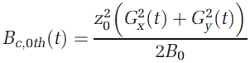
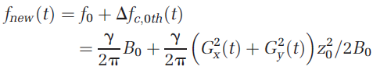
B₀ concomitant field
spatiotemporally varying 3D fields
created simultaneously with the spatial encoding gradient fields
accumulate undesired phase within k‐space data
results in image blurring and spatial shifts
The overall magnetic field
the new demodulation frequency
Weavers, P. T., Tao, S., Trzasko, J. D., Frigo, L. M., Shu, Y., Frick, M. A., . . . Bernstein, M. A. (2018). B0 concomitant field compensation for MRI systems employing asymmetric transverse gradient coils. Magnetic Resonance in Medicine, 79(3), 1538-1544. doi:10.1002/mrm.26790

Slide 7
B₀ concomitant field
Weavers, P. T., Tao, S., Trzasko, J. D., Frigo, L. M., Shu, Y., Frick, M. A., . . . Bernstein, M. A. (2018). B0 concomitant field compensation for MRI systems employing asymmetric transverse gradient coils. Magnetic Resonance in Medicine, 79(3), 1538-1544. doi:10.1002/mrm.26790

Slide 8
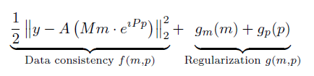
Phase cycling
Ong, F., Cheng, J., & Lustig, M. (2017). General Phase Regularized Reconstruction using Phase Cycling. arXiv e-prints. Retrieved from https://ui.adsabs.harvard.edu/abs/2017arXiv170905374O
Notes:
Unlike the phase difference, the complex difference does not display discontinuities
and does not take on negative values.

Slide 9
Phase cycling
Ong, F., Cheng, J., & Lustig, M. (2017). General Phase Regularized Reconstruction using Phase Cycling. arXiv e-prints. Retrieved from https://ui.adsabs.harvard.edu/abs/2017arXiv170905374O
Notes:
Unlike the phase difference, the complex difference does not display discontinuities
and does not take on negative values.

Slide 10
Phase cycling
Ong, F., Cheng, J., & Lustig, M. (2017). General Phase Regularized Reconstruction using Phase Cycling. arXiv e-prints. Retrieved from https://ui.adsabs.harvard.edu/abs/2017arXiv170905374O
Notes:
Unlike the phase difference, the complex difference does not display discontinuities
and does not take on negative values.

Slide 11
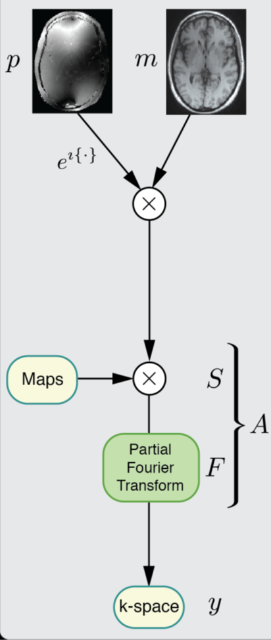
Partial Fourier
Ong, F., Cheng, J., & Lustig, M. (2017). General Phase Regularized Reconstruction using Phase Cycling. arXiv e-prints. Retrieved from https://ui.adsabs.harvard.edu/abs/2017arXiv170905374O
Notes:
Unlike the phase difference, the complex difference does not display discontinuities
and does not take on negative values.

Slide 12
2 Phase Calibration

Slide 13
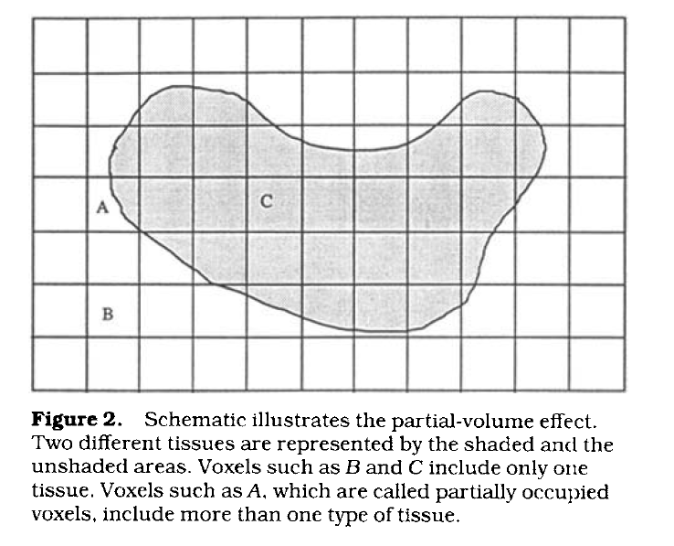
Partial Volume Effects
The relative signal intensity and volume fraction of flowing and stationary spins
The flow type (plug or laminar flow)
The relative size of the vessel and voxel grid
The angulation between flow direction, velocity encoding direction and voxel grid
The relative positions of the vessel cross section and voxel grids
Tang, C. , Blatter, D. D. and Parker, D. L. (1993), Accuracy of phase‐contrast flow measurements in the presence of partial‐volume effects. J. Magn. Reson. Imaging, 3: 377-385.

Slide 14
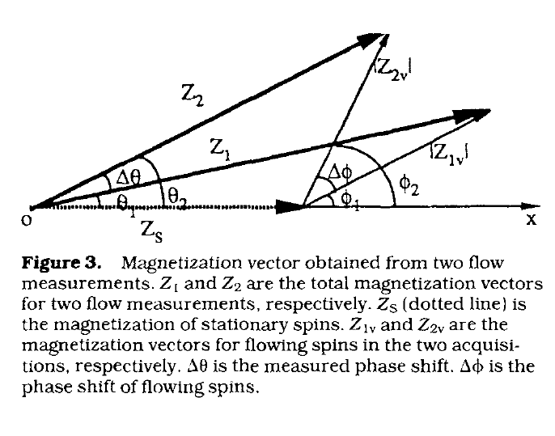
Partial Volume Effects
$$Z_{1v}=\int{ρ_{(v_{z})}}exp (ik_{1}v_{z})dv_{z}$$
$$Z_{2v}=\int{ρ_{(v_{z})}}exp (ik_{2}v_{z})dv_{z}$$
$$θ_{1}=\arctan\left[\frac{|Z_{1v}|sinφ_{1}}{\left|Z_{1v}\right|cosφ_{1}+|Z_{s}|}\right]$$
$$θ_{2}=\arctan\left[\frac{|Z_{2v}|sinφ_{2}}{\left|Z_{2v}\right|cosφ_{2}+|Z_{s}|}\right]$$
$$∆θ=θ_{1}−θ_{2}$$
$$v_{i}=\frac{∆θ}{π}VENC$$
$$Q_{i}=∆sv_{i}$$
$$Q_{m}=\sum_{i}{Q_{i} }$$
Tang, C. , Blatter, D. D. and Parker, D. L. (1993), Accuracy of phase‐contrast flow measurements in the presence of partial‐volume effects. J. Magn. Reson. Imaging, 3: 377-385.

Slide 15
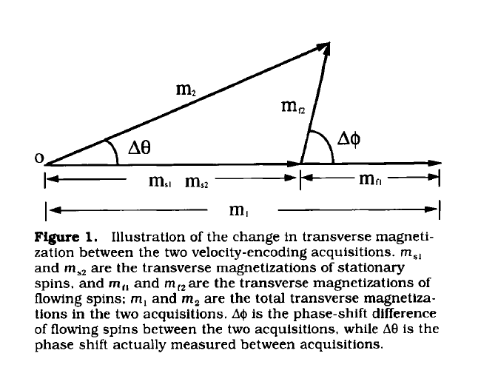
Partial Volume Effects: Calibration -Correction Factor
$$∆s_{f}=η∆s$$
$$∆s_{s}=(1−η)∆s$$
$$Q_{0}=v_{z0}∆s_{f}$$
$$m_{f}=ρ_{f}∆V_{f}$$
$$M_{f}=ρ_{f}∆V$$
$$Q=\frac{VENC∆s}{π}arctan (\frac{m_{f}sin∆φ}{m_{f}cos∆φ+m_{s}})$$
Small-phase-shift approximation:
$$Q=v_{z0}∆s\frac{m_{f}}{m_{f}+m_{s}}$$
$$Q=Q_{0}\frac{M_{f}}{m}$$
$$Q_{c}=Q\frac{m}{M_{f}}$$
$$Q_{total}=\sum_{fully}{Q_{f}}+\sum_{partially}{\frac{m_{i}}{M_{f}}}Q_{i}$$
Tang, C. , Blatter, D. D. and Parker, D. L. (1995), Correction of partial‐volume effects in phase‐contrast flow measurements. J. Magn. Reson. Imaging, 5: 175-180.

Slide 16
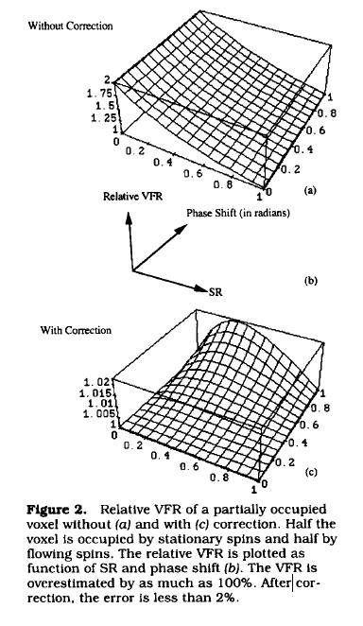
Partial Volume Effects: Calibration
-Correction Factor
$$\frac{Q}{Q_{0}}=\frac{1}{η∆φ}arctan [\frac{sin∆φ}{\frac{SR\left(1−η\right)}{η}+sin∆φ}]$$
$$SR=\frac{ρ_{s}}{ρ_{f}}$$
$$\frac{Q_{c}}{Q_{0}}=\frac{η+(1−η)SR}{η∆φ}arctan [\frac{sin∆φ}{\frac{SR\left(1−η\right)}{η}+sin∆φ}]$$
Tang, C. , Blatter, D. D. and Parker, D. L. (1995), Correction of partial‐volume effects in phase‐contrast flow measurements. J. Magn. Reson. Imaging, 5: 175-180.

Slide 17
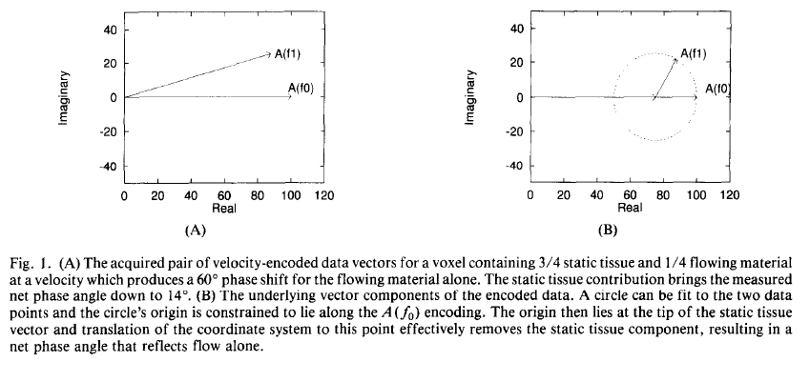
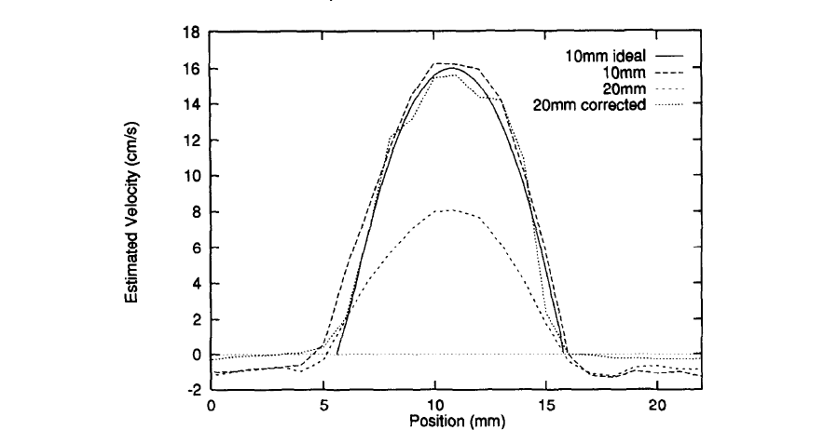
Partial Volume Effects: Calibration
-Origin Translation
$$(x_{c},y_{c})$$
$$A\left(f\right)=Me^{jГ}\int_{−V_{m}}^{V_{m}}{p(v)e^{j2πfv}dv}$$
$$f=γG_{v}τT$$
$$A\left(f_{1}\right)=100[\frac{3}{4}+\frac{1}{4}e^{j(π/3)}]$$
$$A\left(f_{0}\right)=100$$
$$A\left(f_{0}\right)=(x_{0},y_{0})$$
$$A\left(f_{1}\right)=(x_{1},y_{1})$$
$$x_{c}=\frac{1}{2}\frac{\left(y_{0}+y_{1}\right)\left(y_{0}−y_{1}\right)+\left(x_{0}+x_{1}\right)\left(x_{0}−x_{1}\right)}{\left(\frac{y_{1}}{x_{1}}\right)\left(y_{0}−y_{1}\right)+(x_{0}−x_{1})}$$
$$y_{c}=\frac{y_{1}}{x_{1}}x_{c}$$
Hamilton, C. A. (1994). Correction of partial volume inaccuracies in quantitative phase contrast MR angiography. Magnetic Resonance Imaging, 12(7), 1127-1130.

Slide 18
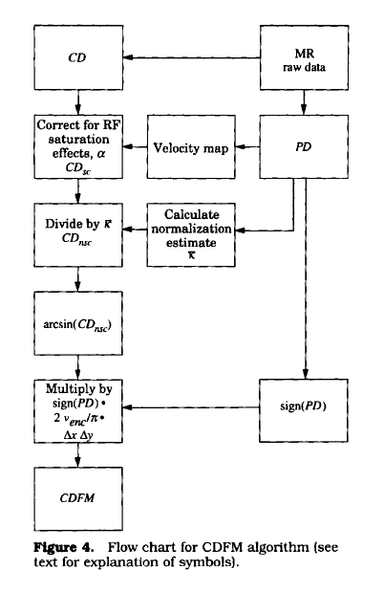
Partial Volume Effects: Calibration- CDFM
$$CD=2\left|S_{f}sin \left(\frac{Φ_{v}}{2}\right)\right|$$
$$CD=к\left(x,y\right)α\left(θ_{flip},v,d,TR,T1\right)η\left(x,y\right)sin \left(\frac{Φ_{v}}{2}\right)$$
$${CD}_{sc}=\frac{CD}{α[θ_{flip},v\left(PD\right),d,TR,T1]}$$
$$\overline{к}=\frac{1}{N_{f0}}\sum_{i=1}^{N_{f0}}{\frac{{CD}_{sc}(i)}{sin [0.5PD(i)]}}$$
$${CD}_{nsc}=\frac{{CD}_{sc}}{\overline{к}}=η(x,y)sin (Φ_{v}/2)$$
$$ψ=\sin^{−1}\left({CD}_{nsc}\right)=\sin^{−1}\left(ηsin (Φ_{v}/2)\right)=\frac{{ηΦ}_{v}}{2}$$
(Small angle approximation)
$$CDFM=sign[PD(x,y)]\frac{2VENC}{π}ψ(x,y)ΔxΔy$$
Polzin, J. A., Alley, M. T., Korosec, F. R., Gristn, T. M., Wang, Y.,... Mistretta, C. A. (1995). A complex-difference phase-contrast technique for measurement of volume flow rates. Journal of Magnetic Resonance Imaging, 5(2), 129-137.

Slide 19
Phase Offset Error
Sources
Eddy current
Concomitant Gradient
Gradient field distortions
Parameters
Vessel position
Imaging plane angles
VENC
Results
Small velocity offset errors often lead to much larger errors in blood flow quantification
Such error exhibits a substantial increase with increasing distance from the isocenter of the MR system
Postprocessing Correction
Manufacturers: ROI in stationary tissue
Estimate offset error in distant stationary tissue- spatially fitting
Repeating the imaging sequence in “phantom”-additional time
Magnetic field monitoring

Slide 20
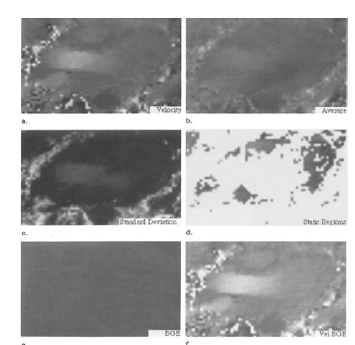
Phase Offset Error: Correction
-Spatially Fitting
$$V_{mean}\left(x,y\right)=\frac{1}{N}\sum_{n=1}^{N}{V(x,y,n)}$$
$$V_{sd}\left(x,y\right)=\sqrt{\frac{1}{N}\sum_{n=1}^{N}{{[V_{mean}\left(x,y\right)−V(x,y,n)]}^{2}}}$$
$$V_{static}\left(x,y,n\right)=V\left(x,y,n\right) if V_{sd}\left(x,y\right)<limit$$
$$V_{error}\left(x,y,n\right)=Ax+By+D$$
$$V_{bge}\left(x,y,n\right)=V\left(x,y,n\right)−V_{error}\left(x,y,n\right)$$
$$B=\frac{[\left(C_{zx}×C_{xy}\right)−(C_{zy}×C_{xx})]}{[\left(C_{xy}×C_{xy}\right)−(C_{yy}×C_{xx})]}$$
$$A=\frac{[C_{zx}−(B×C_{xy})]}{C_{xx}}$$
$$D=Z−AX−BY$$
$I=\sum{i}$, $J=\sum{j}$, $X=\sum{x}$, $Y=\sum{y}$, $C_{ij}=P\left(n\right)×I×J−(I×J)$
$$Z=\sum{V_{static}(x,y,n)}$$
Walker, P. G., Cranney, G. B., Scheidegger, M. B., Waseleski, G., Pohost, G. M., & Yoganathan, A. P. (1993). Semiautomated method for noise reduction and background phase error correction in MR phase velocity data. Journal of Magnetic Resonance Imaging, 3(3), 521–530.

Slide 21
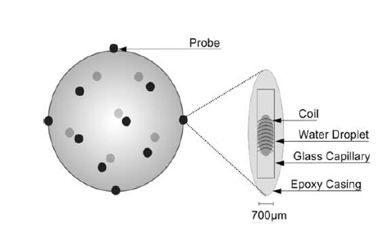
Phase Offset Error: Correction
-Magnetic Field Monitoring
$$\vec{k}\left(t\right)=γ\int_{0}^{t}{\vec{G}}\left(τ\right)dτ=γ\vec{M_{0}}(t)$$
$$\vec{k_{v}}\left(t\right)=γ\int_{0}^{t}{\vec{G}}\left(τ\right)τdτ=γ\vec{M_{1}}(t)$$
$$∆φ\left(\vec{r}\right)=∠\frac{\int{s(\vec{k},\vec{k_{v}}+∆\vec{k_{v}})e^{j\vec{k}\vec{r}}d\vec{k}}}{\int{s(\vec{k},\vec{k_{v}})e^{j\vec{k}\vec{r}}d\vec{k}}}=∆k_{v}v\left(\vec{r}\right)+∆φ_{e}(\vec{r},∆\vec{k_{v}})$$
$$v\left(\vec{r}\right)=\frac{1}{∆k_{v}}∆φ\left(\vec{r}\right)=\frac{VENC}{π}\left(∆φ_{v}\left(\vec{r}\right)+∆φ_{e}\left(\vec{r},∆\vec{k_{v}}\right)\right)$$
$$∆φ_{e}\left(\vec{r_{P}}\right)=\sum_{;=1}^{N}{P_{l}(\vec{r_{P}})}∆k_{l}$$
Giese, D. , Haeberlin, M. , Barmet, C. , Pruessmann, K. P., Schaeffter, T. and Kozerke, S. (2012), Analysis and correction of background velocity offsets in phase‐contrast flow measurements using magnetic field monitoring. Magn. Reson. Med., 67: 1294-1302.

Slide 22
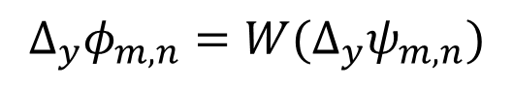
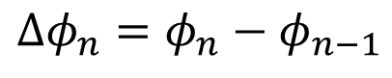
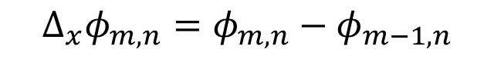
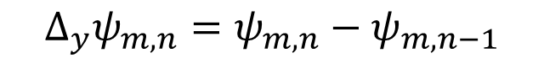
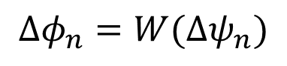
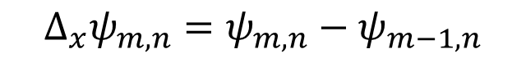
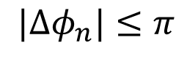
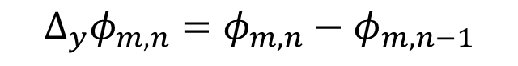
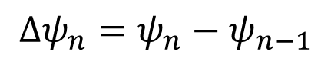
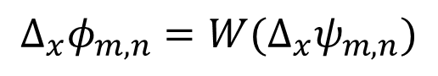
Phase Unwrapping
Path integration (Itoh,1982)
1D
2D
$$∆φ_{n}=φ_{n}−φ_{n−1}$$
$$∆_{x}φ_{m,n}=φ_{m,n}−φ_{m−1,n}$$
$$∆_{y}φ_{m,n}=φ_{m,n}−φ_{m,n−1}$$
$$∆ψ_{n}=ψ_{n}−ψ_{n−1}$$
$$∆_{x}ψ_{m,n}=ψ_{m,n}−ψ_{m−1,n}$$
Smoothness condition:
$$∆_{y}ψ_{m,n}=ψ_{m,n}−ψ_{m,n−1}$$
$$|∆φ_{n}|≤π$$
Smoothness condition:
then:
$$\left|∆_{x}φ_{m,n}\right|≤π, \left|∆_{y}φ_{m,n}\right|≤π$$
then:
$$∆φ_{n}=W(∆ψ_{n})$$
$$∆_{x}φ_{m,n}=W(∆_{x}ψ_{m,n})$$
$$∆_{y}φ_{m,n}=W(∆_{y}ψ_{m,n})$$
Ying, L. , Liang, Z. P. , Munson, D. C. , Koetter, R. , & Frey, B. J. . (2005). Unwrapping of mr phase images using a markov random field model. IEEE Transactions on Medical Imaging, 25(1), 128-136.

Slide 23
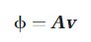
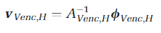
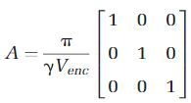
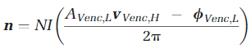
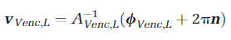
Phase Unwrapping
Dual-VENC Unwrapping
$$VENC_{L} = βVENC_{H} , 0<β<1$$
Loecher, M. , & Ennis, D. B. . (2017). Velocity reconstruction with nonconvex optimization for low-velocity-encoding phase-contrast mri. Magnetic Resonance in Medicine.
Notes:
Dual Venc reconstruction files combine data from high and low Venc acquisitions to reduce the tradeoffs between VNR and dynamic range. To minimize the scan time penaltyfrom added encoding steps, additional radial under-sampling was applied to high Vencdata before the dual Venc reconstruction. Although undersampling introdu-ces errors in the high Venc acquisition, these errors inthe estimated velocities need to be greater than the low Venc to cause errors in the final estimation. 4D PC MRI with Accelerated Dual Venc Encoding.

Slide 24
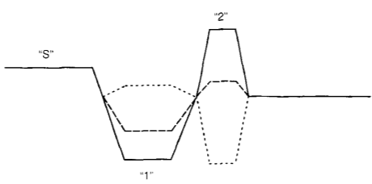
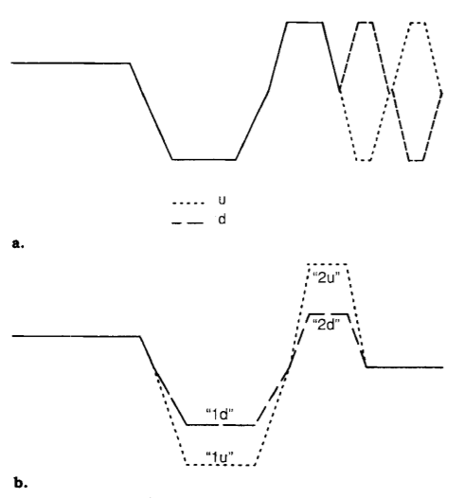
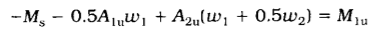
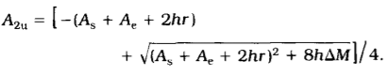
Minimize TE
Bernstein, M. A. , Shimakawa, A. , & Pelc, N. J. . (1992). Minimizing te in moment-nulled or flow-encoded two-and three-dimensional gradient-echo imaging. Journal of magnetic resonance imaging : JMRI, 2(5), 583-588.
Notes:
实现流编码的一种可能方法是将双极梯度瓣添加到流补偿波形中，如图3a所示。这是所谓的“双面”流编码的一个例子:关于M1 = 0对称的梯度矩。通过结合梯度瓣，可以以更短的最小回波延迟交替获得双边编码，如图3b所示。相反，给定一个所需的ΔM，最小持续时间梯度就是“2”波瓣以这种方式反转的梯度。注意式(17)独立于切片选择瓣的一阶矩M，因为和一阶矩的绝对值不相关。

Slide 25
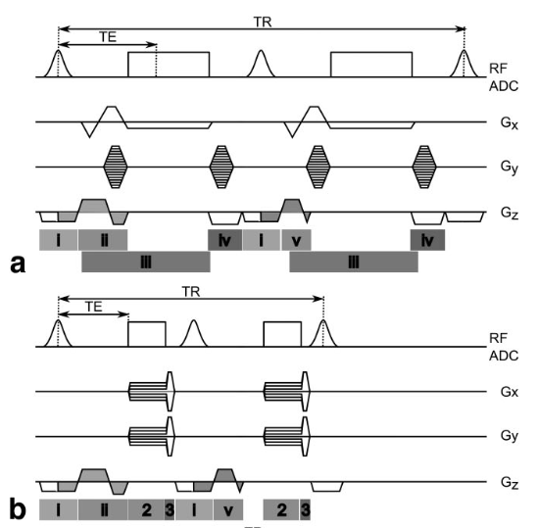
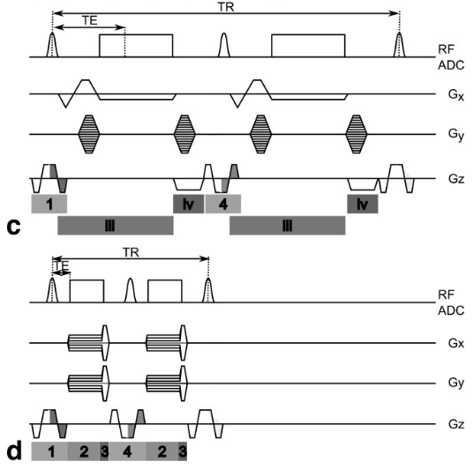
Minimize TE
O'Brien, K. R. , Myerson, S. G. , Cowan, B. R. , Young, A. A. , & Robson, M. D. . (2009). Phase contrast ultrashort te: a more reliable technique for measurement of high-velocity turbulent stenotic jets. Magnetic Resonance in Medicine, 62(3), 626-636.

Slide 26
References
Bernstein, M. A., King, K. F., & Zhou, X. J. (2004). Handbook of MRI pulse sequences. Elsevier Academic Press.
Markl, M., Frydrychowicz, A., Kozerke, S., Hope, M., & Wieben, O. (2012). 4D flow MRI. Journal of Magnetic Resonance Imaging, 36(5), 1015-1036. doi:10.1002/jmri.23632
Funai, A. K., Fessler, J. A., Yeo, D. T. B., Olafsson, V. T., & Noll, D. C. (2008). Regularized Field Map Estimation in MRI. IEEE Transactions on Medical Imaging, 27(10), 1484-1494. doi:10.1109/TMI.2008.923956
Ong, F., Cheng, J., & Lustig, M. (2017). General Phase Regularized Reconstruction using Phase Cycling. arXiv e-prints. Retrieved from https://ui.adsabs.harvard.edu/abs/2017arXiv170905374O
Mansfield, P., & Chapman, B. (1986). Active magnetic screening of coils for static and time-dependent magnetic field generation in NMR imaging. Journal of Physics E: Scientific Instruments, 19(7), 540-545. doi:10.1088/0022-3735/19/7/008
Weavers, P. T., Tao, S., Trzasko, J. D., Frigo, L. M., Shu, Y., Frick, M. A., . . . Bernstein, M. A. (2018). B0 concomitant field compensation for MRI systems employing asymmetric transverse gradient coils. Magnetic Resonance in Medicine, 79(3), 1538-1544. doi:10.1002/mrm.26790

Slide 27
References
Tang, C. , Blatter, D. D. and Parker, D. L. (1993), Accuracy of phase‐contrast flow measurements in the presence of partial‐volume effects. J. Magn. Reson. Imaging, 3: 377-385.
Tang, C. , Blatter, D. D. and Parker, D. L. (1995), Correction of partial‐volume effects in phase‐contrast flow measurements. J. Magn. Reson. Imaging, 5: 175-180.
Hamilton, C. A. (1994). Correction of partial volume inaccuracies in quantitative phase contrast MR angiography. Magnetic Resonance Imaging, 12(7), 1127-1130.
Polzin, J. A., Alley, M. T., Korosec, F. R., Gristn, T. M., Wang, Y.,... Mistretta, C. A. (1995). A complex-difference phase-contrast technique for measurement of volume flow rates. Journal of Magnetic Resonance Imaging, 5(2), 129-137.
Walker, P. G., Cranney, G. B., Scheidegger, M. B., Waseleski, G., Pohost, G. M., & Yoganathan, A. P. (1993). Semiautomated method for noise reduction and background phase error correction in MR phase velocity data. Journal of Magnetic Resonance Imaging, 3(3), 521–530.
Lankhaar, J., Hofman, M. B. M., Marcus, J. T., Zwanenburg, J. J. M., Faes, T. J. C.,... Vonk-Noordegraaf, A. (2005). Correction of phase offset errors in main pulmonary artery flow quantification. Journal of Magnetic Resonance Imaging, 22(1), 73-79.
Chernobelsky, A., Shubayev, O., Comeau, C. R., & Wolff, S. D. (2007). Baseline Correction of Phase Contrast Images Improves Quantification of Blood Flow in the Great Vessels. Journal of Cardiovascular Magnetic Resonance, 9(4), 681–685.
Caprihan, A., Altobelli, S. ., & Benitez-Read, E. (1990). Flow-velocity imaging from linear regression of phase images with techniques for reducing eddy-current effects. Journal of Magnetic Resonance (1969), 90(1), 71–89.

Slide 28
References
Giese, D. , Haeberlin, M. , Barmet, C. , Pruessmann, K. P., Schaeffter, T. and Kozerke, S. (2012), Analysis and correction of background velocity offsets in phase‐contrast flow measurements using magnetic field monitoring. Magn. Reson. Med., 67: 1294-1302.
Nayak, K. S., Nielsen, J., Bernstein, M. A., Markl, M., D. Gatehouse, P., M. Botnar, R.,... Raman, S. V. (2015). Cardiovascular magnetic resonance phase contrast imaging. Journal of Cardiovascular Magnetic Resonance, 17(1), 71.
Holland, B. J., Printz, B. F., & Lai, W. W. (2010). Baseline correction of phase-contrast images in congenital cardiovascular magnetic resonance. Journal of Cardiovascular Magnetic Resonance, 12(1), 11.
Gatehouse, P. D., Rolf, M. P., Bloch, K. M., Graves, M. J., Kilner, P. J., Firmin, D. N.,... Hofman, M. B. (2012). A multi-center inter-manufacturer study of the temporal stability of phase-contrast velocity mapping background offset errors. Journal of Cardiovascular Magnetic Resonance, 14(1), 72.

Slide 29
References
Itoh, K. . (1982). Analysis of the phase unwrapping algorithm. Applied Optics, 21(14), 2470.
Ying, L. , Liang, Z. P. , Munson, D. C. , Koetter, R. , & Frey, B. J. . (2005). Unwrapping of mr phase images using a markov random field model. IEEE Transactions on Medical Imaging,25(1), 128-136.
Arevalillo-Herráez M, Gdeisat, M. A. , & Burton, D. R. . (2009). Hybrid robust and fast algorithm for three-dimensional phase unwrapping. Applied Optics, 48(32), 6313-23.
Loecher, M. , & Ennis, D. B. . (2017). Velocity reconstruction with nonconvex optimization for low-velocity-encoding phase-contrast mri. Magnetic Resonance in Medicine..
Carrillo, H., Osses, A., Uribe, S., & Bertoglio, C. (2019). Optimal Dual-VENC Unwrapping in Phase-Contrast MRI. IEEE Transactions on Medical Imaging, 38(5), 1263-1270.
Bernstein, M. A. , Shimakawa, A. , & Pelc, N. J. . (1992). Minimizing te in moment-nulled or flow-encoded two-and three-dimensional gradient-echo imaging. Journal of magnetic resonance imaging : JMRI, 2(5), 583-588.
O'Brien, K. R. , Myerson, S. G. , Cowan, B. R. , Young, A. A. , & Robson, M. D. . (2009). Phase contrast ultrashort te: a more reliable technique for measurement of high-velocity turbulent stenotic jets. Magnetic Resonance in Medicine, 62(3), 626-636.

